Slide 1

HAMILTON POLICE SERVICE
2022 USE OF FORCE REPORT

Slide 2
OUTLINE
Criminal Code Use of Force
Ontario Use of Force Model
Perception of Self
Police Ambushes
Presentation of Use of Force Statistics
Notes:
Criminal Code Use of Force – PC NASH
Ontario Use of Force Model – PC NASH
Perception of Self – PC NASH
Police Ambushes – PC NASH
Presentation of Use of Force Statistics –
Sergeants CIARMOLI and GIULIANI

Slide 3

SECTION 25 – CRIMINAL CODE OF CANADA
Protection of persons acting under authority
1. Every one who is required or authorized by law to do anything in the administration or enforcement of the law
(b) As a Peace Officer or Public Officer
Is, if he acts on reasonable grounds, justified in doing what he is required or authorized to and in using as much force as is necessary for that purpose

Slide 4

SECTION 26 – CRIMINAL CODE OF CANADA
Excessive Force
Everyone who is authorized by law to use force is criminally responsible for any excess thereof according to the nature and quality of the act that constitutes excess.

Slide 5
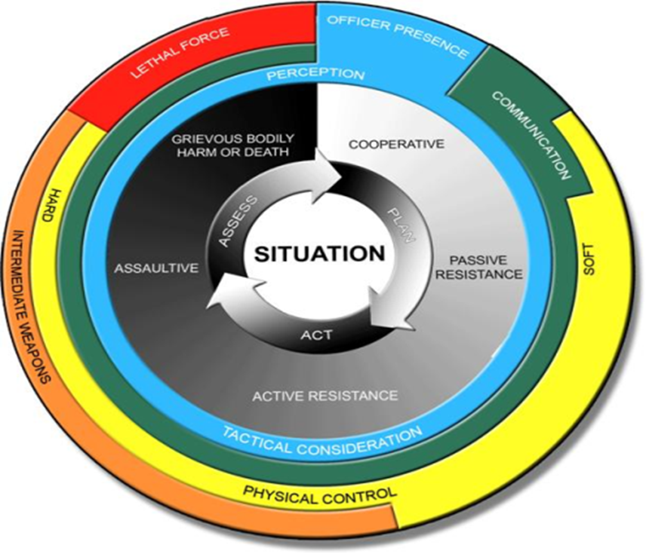
ONTARIO USE OF FORCE MODEL

Slide 6






ONTARIO USE OF FORCE MODEL
Officers must asses various aspects of the immediate situation which can be categorized into six different conditions:
Environment (weather, daylight, location)
Number of subjects
Perceived subjects abilities (emotional state, physical size, skills, drugs / alcohol)
Knowledge of subject (criminal history, prior contact)
Time and distance (seriousness of situation, escape routes)
Potential attack signs (ignoring commands, ceasing all movement, aggressive stance)

Slide 7
PERCEPTION OF SELF
Fears
Skill/ability/ training
Fatigue
Personal experience
Injuries
Strength/overall fitness
Sight/vision

Slide 8












TOTAL USE OF FORCE OPTIONS
Less than 1% of incidents involved use of force
Total number of public contacts: 270,500*
Number of use of force reports submitted: 387
50
0
1
91
67
108
35%
-**
-**
14%
3%
18%
163
3
23
4
6
32
23%
-**
21%
-**
-**
45%
*Includes traffic stops, calls for service and arrests. **Numbers are too small to calculate percentage

Slide 9
CALL TYPE
The charts do not equal the number of UoF reports submitted as officers have the option of identifying more than one call type.
The tactical column indicates reports submitted by ERU and includes high-risk search warrants, vehicle stops and arrests.

Slide 10
WEAPONS CARRIED BY SUBJECT
In 2022, 66% of Use of Force reports involving a human subject indicated the subject had a weapon or had access to one.
In 12% of Use of Force reports, firearms were reported as the most serious weapon.

Slide 11
USE OF FORCE BY YEARS OF SERVICE
A UoF report must be filled out for all officers in a common incident. Only ERU may submit a team report.
Uniform patrol is responsible for 73% of UoF submissions.
Nearly 74% of officers completing a UoF report have 0-10 years of service.

Slide 12
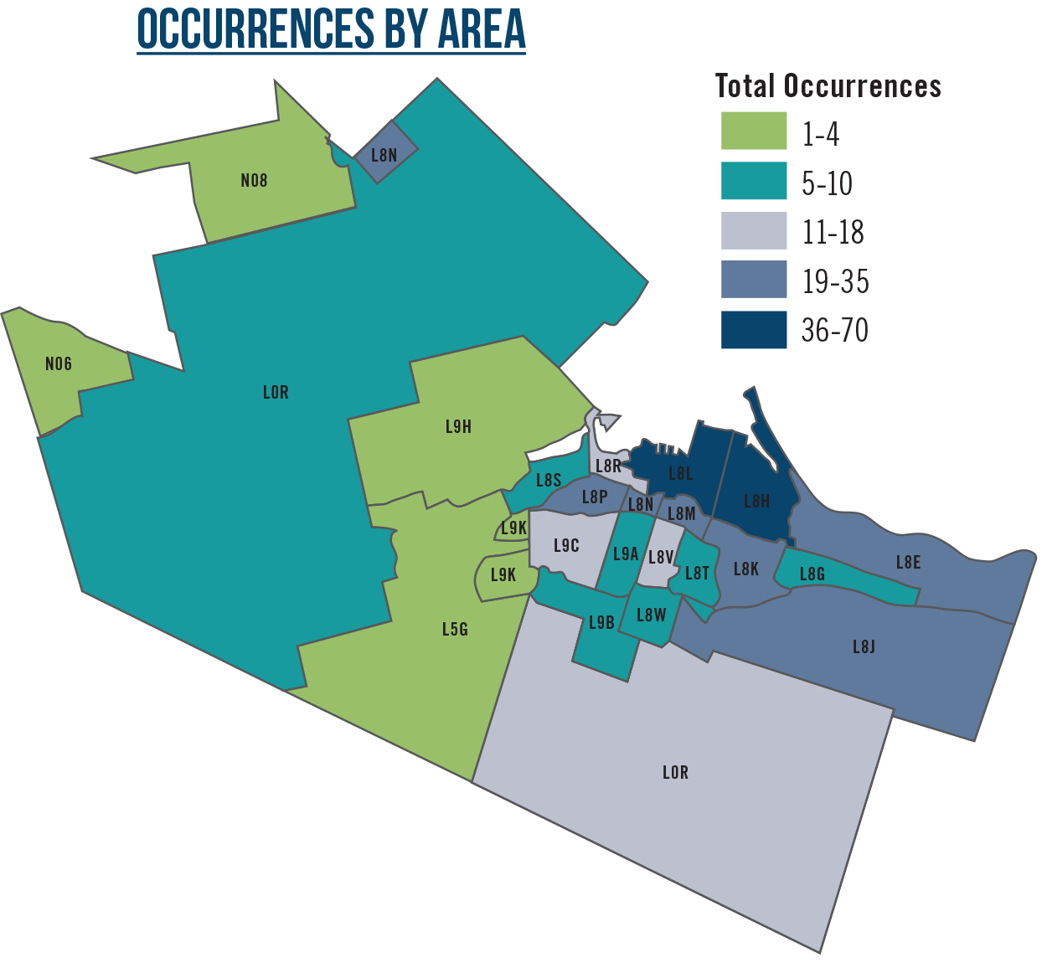
OCCURRENCES BY AREA
There were 382 unique occurrences, where a postal code was available.
In 2022, the majority of occurrences took place in the L8H forward sortation area (FSA).
Only 67% of subjects has a Hamilton FSA.
111 are listed as no fixed address, unknown or information is not available.

Slide 13
SUBJECT RACE
In 2020, police services were required to track the race of individuals involved in UoF encounters with police. As outlined by the Ministry of the Solicitor General, The determination is based solely on an officer’s perception.
Not all subjects are from Hamilton.
In 2022, HPS members submitted 387 UoF reports where force was used on a person. There were a total of 516 subjects.
Due to UoF form limitations, there were 33 subjects whose race could not be identified.

Slide 14
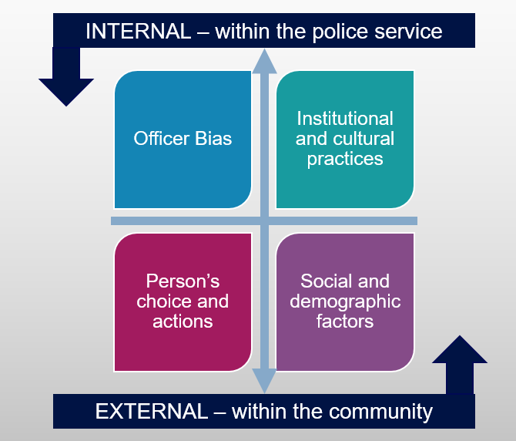
DISPARITY INDEX

Slide 15
DISPROPORTIONALITY INDEX (Incidents vs Population)
Perceived Race
% of Population
% of Incidents
Disproportionality Index
(% of Incidents / % of Population)
0.92
0.17
1.28
0.42
1.12
0.71
3.41
Census profile, 2021 Census – Hamilton, Census division [Census division], Ontario and Ontario [Province] (statcan.gc.ca)
40.8% The number of ‘Confirmed Hamilton Residents’
Interpreting the Disparity Index
Under-representation
Over-representation
Gross over-representation
>3.0
>1.5
>3.0

Slide 16
DISPROPORTIONALITY INDEX (Incidents vs Arrests + Apprehensions)
Perceived Race
% of Arrests + % of Apprehensions
% of Incidents
Disproportionality Index
(% of Incidents / % of Arrest + % of Apprehensions)
0.91
1.54
0.44
0.57
4.34
1.58
200 individuals with no-race identity were excluded from the analysis
In this case, the racial disproportionality index is appropriate to assess whether there might be an overrepresentation or underrepresentation of racial groups in a service, program or function.
Interpreting the Disparity Index
Under-representation
Over-representation
Gross over-representation
>3.0
>1.5
>3.0

Slide 17
UNIFORM PATROL
AND ERU
MOST LIKELY TO ENCOUNTER INCIDENTS REQUIRING FORCE
THERE IS A
7%
IN UOF OVER 2021

