Slide 1
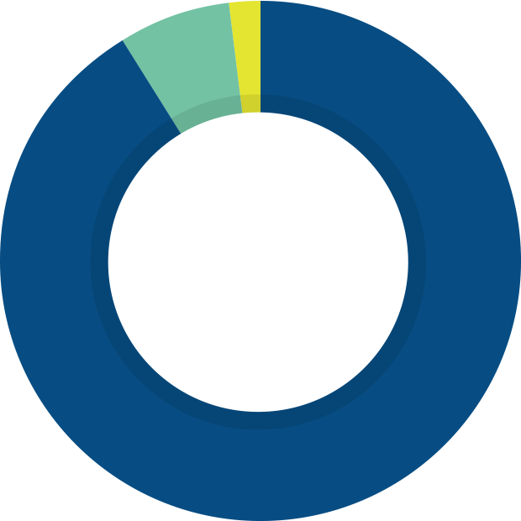
2023 BUDGET
Capital Expenditure
1.85%
Salary/Wages/Benefits
89.17%
$3.58 MILLION
Total Net Budget
$193.60
MILLION
$172.64
MILLION
$17.38 MILLION
Operating Expenditure
8.98%

